Slide 1
Module 2 WORD LEVEL ANALYSIS

Slide 2
INTRODUCTION
NLP involves different levels of complexities of processing. One way to analyse natural language text is by breaking down into constituent units (words, phrases, sentences and paragraph) and then analyse these units.
Word level analysis focuses on NLP work carried out at word level, including characterizing word sequences, identifying morphological variants, detecting and correcting misspelled words, and identifying correct parts of speech of a word.
Regular expressions are used for describing words and their implementation is done using finite-state automaton (FSA).
FSAs and their variants like finite state transducers have found useful applications in speech recognition and synthesis, spell checking, and information extraction.

Slide 3
Regular Expressions
Regular Expression or regexes for short, are pattern matching standard for string parsing and replacement.
They are powerful way to find and replace strings that take a defined format.
Example: RE can be used to parse dates, urls and email addresses, log files, configurations files, command line switches, or programming scripts.
They are tools for the design of language compilers and have been used in NLP for tokenization, describing lexicons,
Regular expression were originally studied as a part of theory of computation .They were first introduced by Kleene(1956).
A regular expression is an algebraic formula whose value is a pattern consisting of a set strings called the language of the expression.

Slide 4
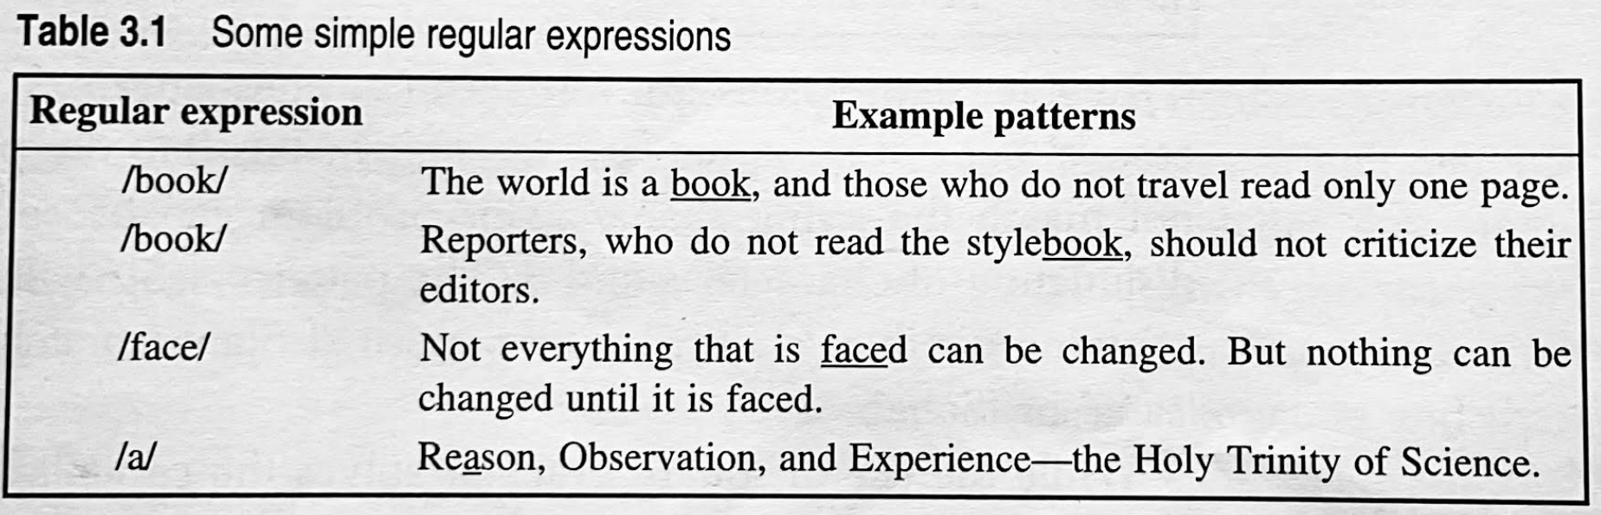
Regular Expressions
The simplest kind of RE contains a single symbol, eg. /a/ denotes the set of strings containing the character ‘a’.
RE may specify a sequence of characters, eg. /supernova/, denotes the set that contains the string ‘supernova’.

Slide 5
Character Classes
Characters are grouped by putting them between square brackets .
Any character in the class will match one character in the input.
For example, the pattern /[abcd]/ will match (any of) a,b,c, and d.
The regular expression /[0123456789]/ specifies any single digit.
A dash (-) is used to specify a range
/[abcdefghijklmnopqrstuvwxyz]/ can be written as /[a-z]/ to specify any lower case letter.
/[m-p]/ specifies any one of the characters from m to p (m, n, o, or p)
/[5-9]/ specifies any on of the characters 5, 6, 7, 8, or 9
Regular Expression can also specify what a single character cannot be, by the use of a caret at the beginning.
/[^ x]/ matches any single character except x.

Slide 6
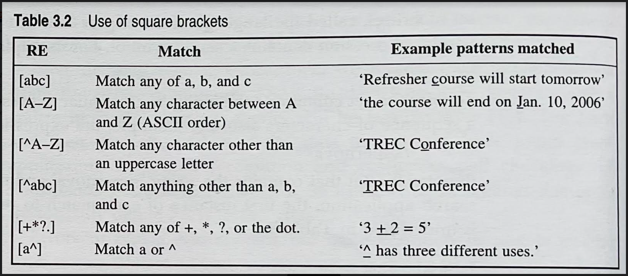
Character Classes

Slide 7
Character Classes
Regular expressions are case sensitive
The pattern /s/ matches a lower case ‘s’ but not an uppercase ‘S’.
The pattern /sana/ will not match the string /Sana/
The problem is solved by using the disjunction of character s and S.
The pattern /[sS]ana/ matches both the string ‘sana’ or ‘Sana’.
The pattern /[sS]upernova[sS]/ matches ‘supernovas’ ‘Supernovas’ ‘supernovaS’ ‘SupernovaS’ but not the string ‘supernova’. This is solved with the use of a question mark /?/.
A Question mark (?) makes the preceding character optional, ie. zero or one occurrence of the previous character.
The regular expression /supernovas?/ matches both supernova and supernovas
To specify repeated occurrences of a character the * operator called the Kleene * (pronounced as cleany star) is used.
The * operator specifies zero or more occurrences of a preceding character or regular expression.
The regular expression /b*/ will match any string containing zero or more occurrences of b. It will match ‘b’, ‘bb’ or ‘bbbb’. It will also match ‘aaa’ as it contains zero occurrence of ‘b’.
To match a string containing one or more ‘b’s, the regular expression is /bb*/ (b followed by zero or more b’s). This will match the strings ‘b’, ‘bb’, ‘bbb’, ‘bbbb’.
The regular expression /[ab]*/ specifies zero or more ‘a’s or ‘b’s. This will match the strings like ‘aa’, ‘bb’ or abab’.

Slide 8
Character Classes
• + one or more occurrences of the previous character.
(^) anchor to specify a match at the beginning of a line
($) anchor to specify a match at the end of a line
(.) wildcard character /.at/ => cat, bat, rat….

Slide 9
RE-Character Classes
R.E
.
\n
\t
\d
\D
\w
\W
\s
\S
\
Description
the dot matches any single character.
Matches a new line character Matches a tab
Matches a digit Matches a non-digit
Matches an alphanumeric character Matches a non-alphanumeric character
Matches a whitespace character Matches a non-whitespace character Use \ to escape special character

Slide 10
RE-Character Classes
/…..berry/ ten letter string that ends in berry Strawberry
Tanveer or Siddiqui => disjunction operator shown by pipe symbol (|)
Blackberry| blackberries
Exercise
Suppose we need to check if a string is an email address or not .An email address consist of a non-empty sequence followed by the 'at' symbol ,@, followed by another non-empty sequence of character ending with pattern like .xx,.xxx,.xxxx etc . Write the regular expression for an email address???
Write the regular expression for an URL.

Slide 11
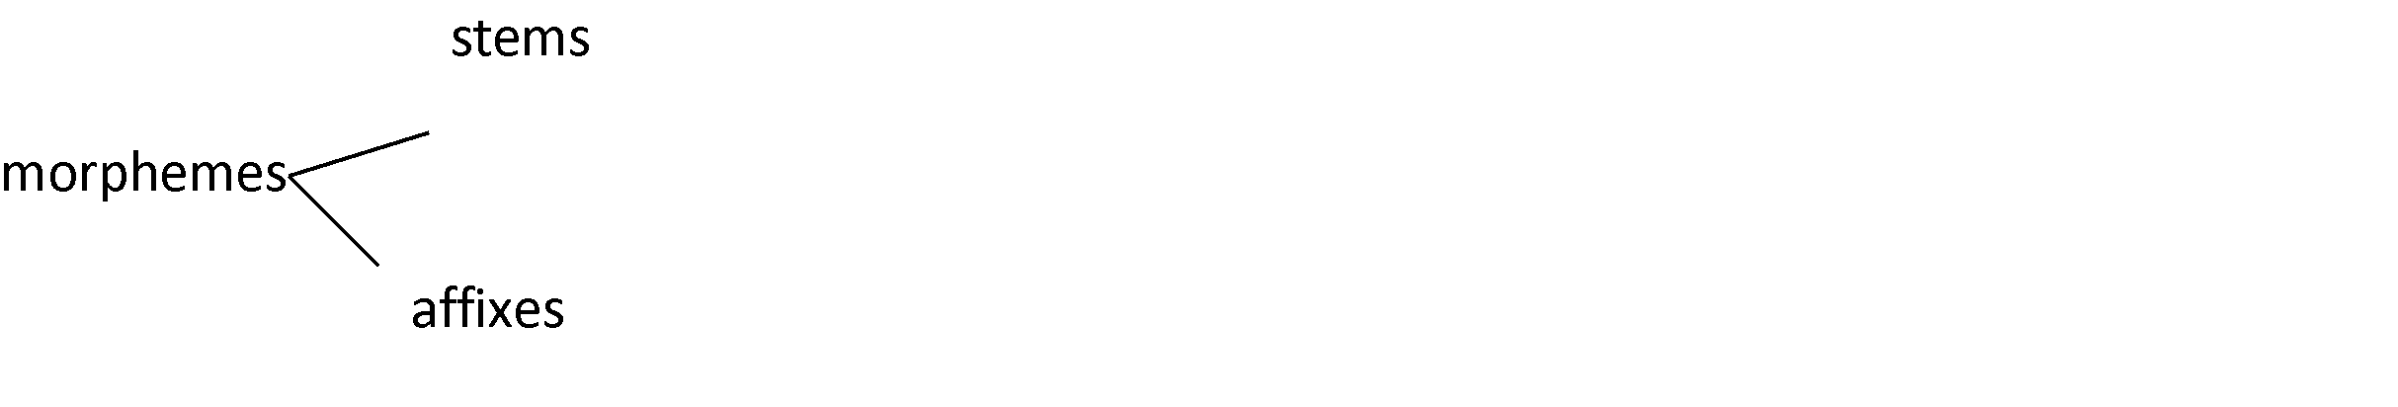
Morphological Parsing
- Morphology is a sub discipline of linguistics.
word structure
from smaller units.(morphemes)
- Study
formation of words
Goal to discover the morphemes that build a given word.
Morphemes □ smallest meaning-bearing units in a language.
Example: ‘bread’, ‘eggs’ 2 morpheme? egg+ S

Slide 12
Morphological Parsing
Stem- main morpheme i.e. the morpheme that contain the central meaning.
Affixes- modify the meaning given by the stem
Prefix Suffix Infix Circumfix
Example:
Pilli – cat – pillulu where ulu is plural
Chevi – ear – chevulu

Slide 13
Morphological Parsing
Three main ways of word formation:
Inflection
Derivation
Compounding
Inflection □
a root word is combined with a grammatical morpheme
to yield a word of the same class as the original stem.
Example: eggs==egg+s
Derivation □
combines a word stem with a grammatical morpheme
to yield a word belonging to a different class. Ex: formation
of the noun “ Computation” from the verb “ compute” compute (V) +tion ? computation (N).
•
Noun Verb or Adjective => Nominalization
Compounding is the process of merging two or more words to form a new word.
Ex: personal computer, desktop, overlook.

Slide 14
Morphological Parsing
Parsing takes and producing some sort of
for it.
an input
structures
Morphological parsing takes as input the inflected surface form of each word in a text. Output □ produces
the of a canonical form of the word and a set of tags showing its syntactical category
parsed form
and morphological characteristic.
A morphological parser uses the following information sources:
Lexicon: Lexicon lists stems and affixes together with basic information about them.
: ordering among the morphemes that form a word. Can’t be arranged arbitrarily.
Morphotactics
Example : restlessness ? Rest-ness-less
describes the way morphemes are arranged or touch each other.
Orthographic: Spelling rules that specify the changes that occur when two given morphemes combine.
  Example : y □ier spelling rule changes
  Easy □easier not to easyer EASY +ier====EASIER==EASYIER consisting

Slide 15
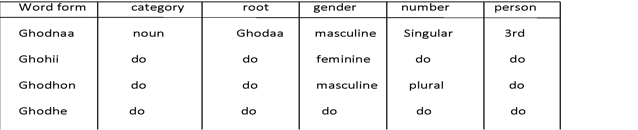
Morphological Parsing
Morphological analysis can be avoided if an exhaustive lexicon is available that lists features for all the word forms of all the roots.
But this approach has several limitation:
it puts a heavy demand on memory.
- have to list every form of the word which results in a large number of, often redundant, entries is the lexicon.
Exhaustive lexicon fails to show the relationship between different roots having similar word forms.
-approach fails to capture linguistic generalization , which is essential to develop a system capable of understanding unknown words.
Morphologically complex languages like Turkish, the no of possible word forms may be theoretically infinite.

Slide 16
Morphological Parsing
The simplest morphological systems are stemmers that collapse morphological variations of a given word to one lemma or stem. They do not require a lexicon.
Stemmers have been used in information retrieval.
lovins(1968) and porter(1980)
stemmers do not use a lexicon, instead they make use of rewrite rules of the form: ier -> y (eg: earlier->early)
ing ->e (eg: playing->play)
Stemming algorithms work in two steps:
1)Suffix removal: removes predefined endings from words. 2)Recoding: adds predefined endings to the outputs of the first step.
- performed sequentially in lovin’s stemmer – simultaneously in porter’s stemmer. ational ->ate
to transform word such as 'rotational' into 'rotate’
⇒ organization into organ, noise into noisy.
⇒ Reduces only suffixes; Prefixes and compounds are not reduced.

Slide 17
Morphological Parsing
A more efficient two-level morphological model proposed by koskenniemi(1983),can be used for highly inflected languages.
-a word is represented as
surface level form-> the actual spelling of the word
lexical level form-> the concatenation of its constituent morphemes
Morphological parsing is a mapping from the surface level into morpheme and feature sequences on the lexical level
-surface form
'playing’
-lexical form
play+v pp
=>stem 'play' followed by the morphological information +v, +pp surface level: playing
lexical: play+v pp
surface form "books"
lexical form book +N +PL ->morphological information->surface level form is a plural noun
-This model is usually implemented with a kind of finite state automata=>finite state transducer(FST)

Slide 18
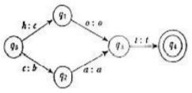
Morphological Parsing
FST -2 state automaton
-recognizes or generates a pair of strings.
-passes over the input string by consuming the input symbols on the tape it traverses and consists it to the output string in the form of symbols
Finite state transducer is a 6 tuple (∑1, ∑2,Q,ᵟ,S,F)
A simple transducer that accepts two strings, hot and cat maps them into cot and bat.

Slide 19
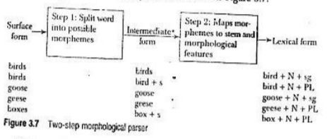
Morphological Parsing
Two level Morphology using FST
To get the surface form of a word to its morphological analysis, 2steps:

Slide 20
Morphological Parsing
•
First Step:
Words into possible combination
Ex:
birds= bird + s, boxes=box + s (or) boxe + s
•
Second Step:
Use lexicon to look up the categories of the stems and meaning of the affixes.
Ex:
bird + s = bird + N + PL, box+ s = box + N + PL, boxe is not legal
Spouses, parses => spouse + s ,Parse + s => correct. Orthographic rule = handles the spelling variations
Spelling rule says add ‘e’ after -s,-z,-x,-ch,-sh before the s Ex: dishes

Slide 21
Morphological Parsing
Steps – implemented – transducer
Build two transducers:
One : maps the surface form ? intermediate form Two: maps the intermediate form? lexical form
Develop FST based morphological parser for singular and plural nouns.
The plural form—s or –es => miss or ass
•
Required translation is the deletion of e in morpheme boundary.
Words ending in xes, ses, zes
Ex: suffixes, boxes

Slide 22
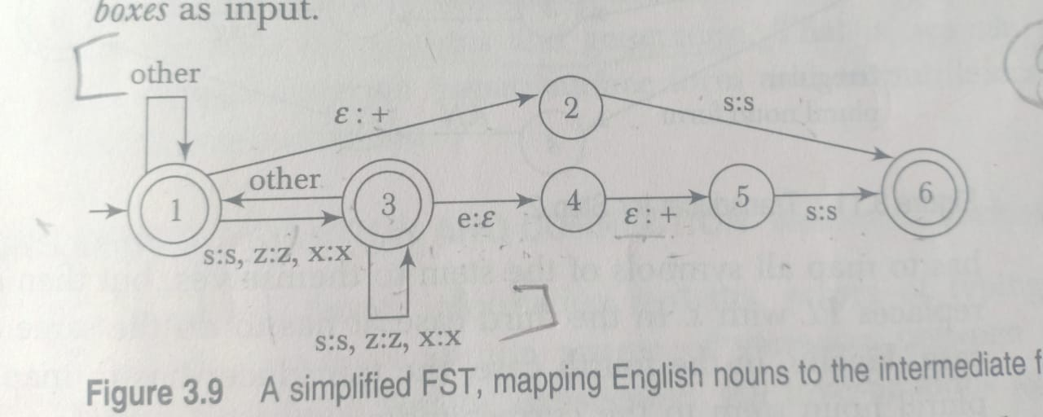
Morphological Parsing

Slide 23
Morphological Parsing
Next step : develop transducer does mapping from intermediate level to lexical level
The input to the transducer:
Regular noun stem, Eg. bird,cat
Regular noun stem + s, eg. Bird+ s
Singular irregular noun stem, eg. Goose
Plural irregular noun stem, eg. Geese

Slide 24
Morphological Parsing
(1): map all symbols of the stem to themselves and then output N and Sg.
(2): map all the symbols of the stem to themselves and then output N and replaces PL with Sg.
(3): same as first case.
(4):map the irregular plural noun stem to the corresponding singular stem(eg : geese- goose) and then add N and PL.

Slide 25
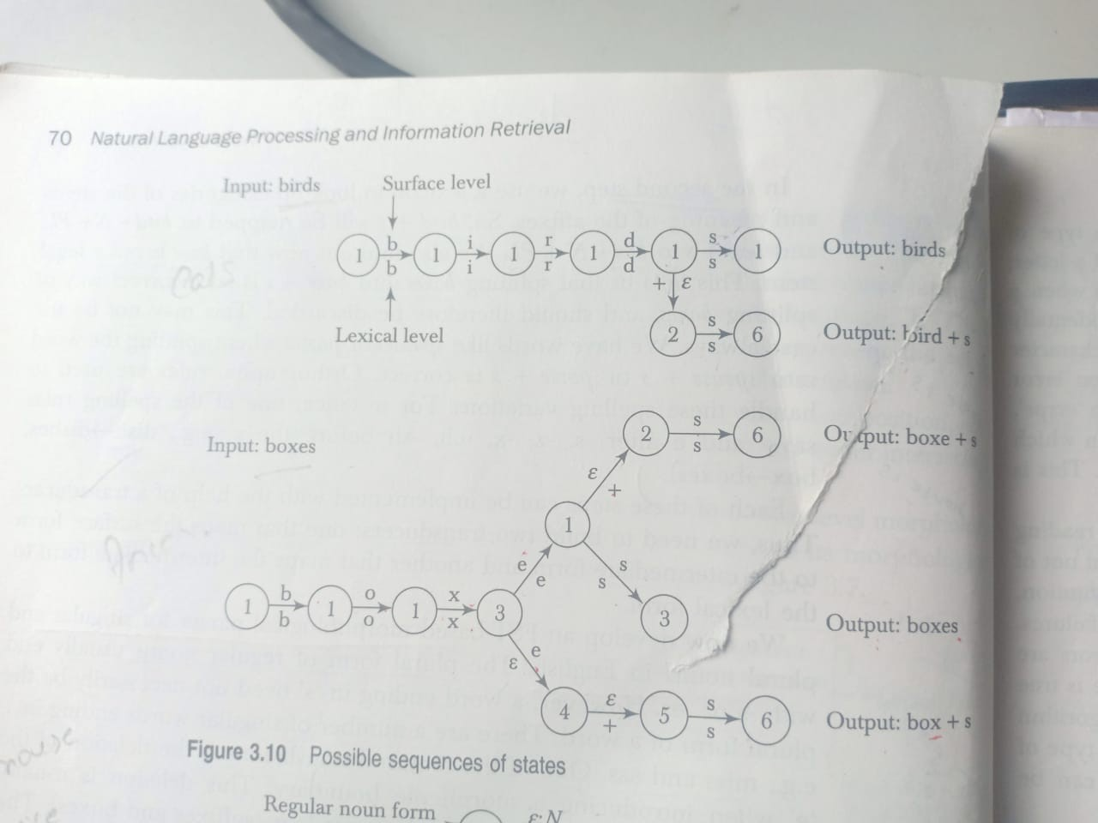
Morphological Parsing

Slide 26
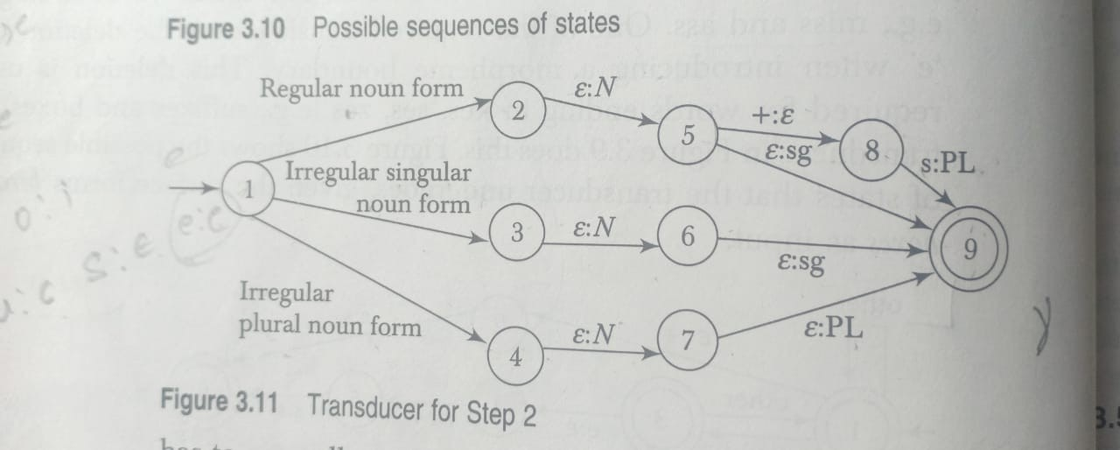
Morphological Parsing

Slide 27
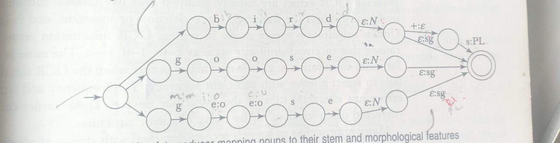
Morphological Parsing

Slide 28
Spelling Error Detection and Correction
Errors of typing and spelling causes variation between strings
*Single character omission
*Insertion
*Substitute
*Reversal
Damearu (1964) reported that over 80% of the typing errors were single_error misspelling 1)Substitution of a single letter
2)omission of a single letter 3)Insertion of a single letter 4)Transposition of two adjacent letters

Slide 29
Spelling Error Detection and Correction
Single character omission occurs when a single character is missed(deleted). E.g. when a concept is accidentally typed as 'concpt'.
Insertion error refers to the presence of an extra character is a word. E.g. when 'error' is misspell as 'errorn'.
Substitution error occurs when a wrong letter is typed in place of the right one. E.g. 'errpr' where 'p' appears in place of 'o'.
Reversal refers to a situation in which the sequence of characters is reversed. E.g. 'aer' instead of 'are' also called as transposition.
Optical Character Recognition (OCR) and other automatic reading devices introduce errors of substitution, deletion and insertion but not of reversal. OCR errors are usually grouped into five classes:

Slide 30
Spelling Error Detection and Correction
OCR errors are usually grouped into five classes:
Substitution
Multi-substitution(or ) framing.
Space deletion (or)
insertion.
Failures.

Slide 31
Spelling Error Detection and Correction
OCR substitution errors are caused due to visual similarity such as, c->e , r->n. Multi-substitution :m->rn. Failures occur when OCR algorithm fails to select a letter with sufficient accuracy. The frequency and type of errors can be corrected using 'context' or by using linguistic structures.
Spelling errors are mainly due to phonetic and it belong one of two distinct categories:
  Non word errors- when an error results in a word that does not appear in a lexicon or valid orthographic word form, it's termed as non -word error. Ex: Mouse: rnouse
  Real word errors- results in actual words of the language. It occurs due to typographical mistakes or spelling errors. Meet meat
E.g. Substituting the spelling of a homophone or near homophone such as Peace for piece (or) Meat for meet.

Slide 32
Spelling Error Detection and Correction
Real word error cause:-
i)Local syntactic errors. ii)Global syntactic errors. iii)Semantic errors.
iv)Discourse errors or pragmatic levels.
To decide a word is wrong is only by contextual information.

Slide 33
SPELLING CORRECTION
It consists of detecting and correcting errors.
Error detection is the process of finding misspelled words and
Error correction is the process of suggesting correct words to a misspelled words.
These sub-problems are solved in 2 ways:
Isolated-error detection and correction.
Context-dependent error detection and correction.
Each word is ,independent of its context. Detecting whether or not a word
seems simple
checked separately
is correct
-why not to look up the word in a lexicon? There are many problems associated with this strategy:
Strategy requires the containing all correct words , such lexicon would take a long time to
existence of a lexicon
compile and occupy a lot of space.
Some languages are highly productive. Its
impossible to list
all the correct words of such languages.
This strategy fails , when
spelling error produces a word
that belongs to the lexicon. E.g. when 'theses' in written in
place of 'these’. Such error is called real-word error. Teh the
Larger the lexicon, the more likely it's that an error goes undetected, because the chance of a word being found is
greater in a large lexicon.

Slide 34
SPELLING ERROR CORRECTION ALGORITHM
Context-dependent error detection and correction:
utilize to detect and correct error. This requires grammatical analysis and is thus more
the context of a word
complex and language dependent.
SPELLING ERROR CORRECTION ALGORITHM
Minimum edit distance: The minimum edit distance between two strings is the minimum number of operations required to transform one string into another. Cat-□ bat
2. Similarity key technique: The idea is to change a given such that similar strings will change
string into a key
into same key. The SOUNDEX system(Odell and Russell 1918) is an example which is used in phonetic spelling correction application.

Slide 35
SPELLING ERROR CORRECTION ALGORITHM
n-gram based techniques: used for both non-word and real-word error detection because in English alphabet, certain ,bi-grams and tri-grams of letters never occur. E.g. tri-gram qst and the bi-gram qd.
This information can be used to handle non-word error. n-gram techniques requires large corpus or dictionary as training data. So that n-gram table of possible combinations of letters can be complied.
Neural nets: These have the ability to do associative recall based on incomplete and noisy data. They can be trained to adapt to specific error patterns. The drawback is that they are computationally expensive.
Rule-based techniques: A set of rules (heuristics) derived from knowledge of a common spelling error pattern is used to transform misspelled words into valid words. E.g. Many errors occur from the letters 'ue' being typed as ‘ eu ‘, then we may write a rule that represents this. The

Slide 36
Minimum Edit Distance
The minimum edit distance between two strings is the minimum number of operations (insertions, deletions or substitutions) required to transform one string into another.
For example, the minimum edit distance between tutor and tumour is 2. We substitute 'm' for 't' and insert 'u' before 'r'. No smaller edit sequence can be found for this conversion.
Edit distance between two strings can be represented as a binary function, ed, which maps two strings to their edit distance.
ed is symmetric. For any two strings, s and t, ed(s,t) is always equal to ed(t,s).
Edit distance can be viewed as string alignment problem, by aligning two strings we can measure the degree to which they match.
There can be more than one possible alignment between two strings. The best possible alignment corresponds to minimum edit distance between the strings.
The alignment shown below between tutor and tumour has a distance of 2.
T U T O - R (A dash (-) indicates insertion)
T U M O U R (substitution occurs when two alignment symbols do not match (shown in bold).

Slide 37
Minimum Edit Distance
A weight or cost is associated with each operation. The Levenshtein distance between two sequences is obtained by assigning a unit cost to each operation.
Dynamic programming algorithms are used to find minimum edit distances between two sequences.
The dynamic programming algorithm for minimum edit distance is implemented by creating an edit distance matrix.
The matrix has one row for each symbol in source string and one column for each matrix in the target string.

Slide 38
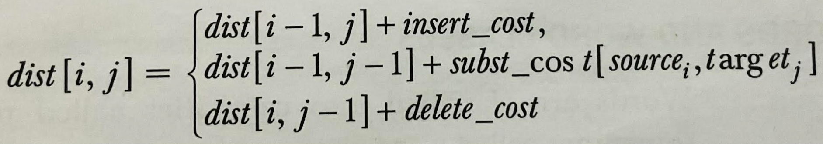
Minimum Edit Distance
The (i , j)^{th} cell in this matrix represents the distance between the first 'i' character of the source and the first 'j' character of the target.
Each cell can be computed as a simple function of its surrounding cells.
The value in each cell is computed in terms of three possible paths.

Slide 39
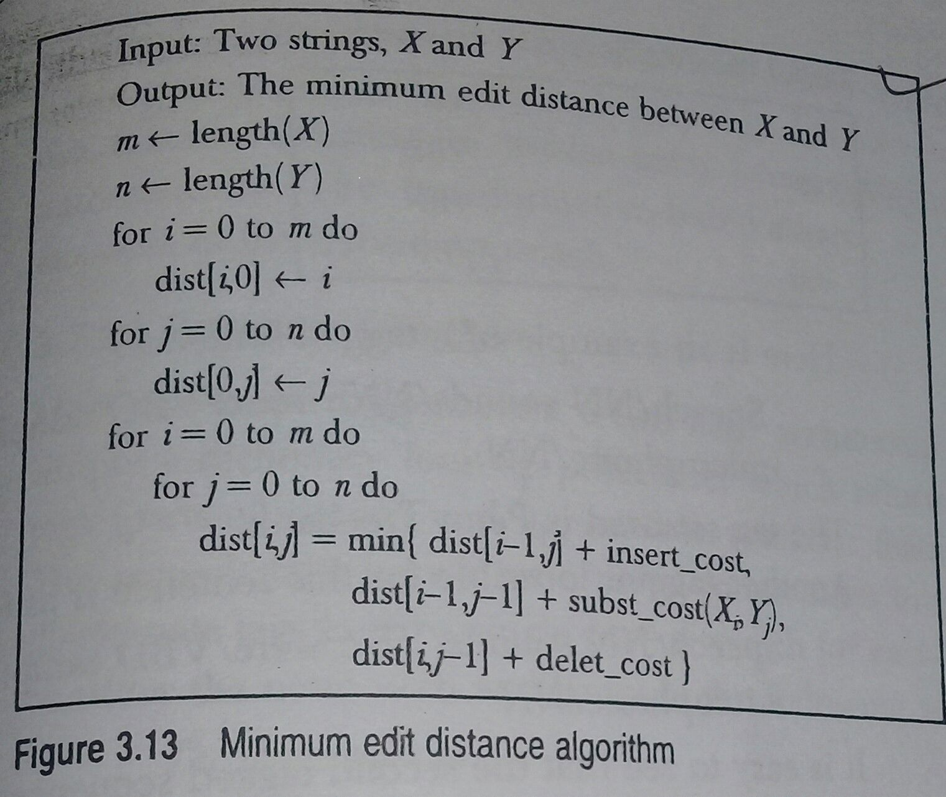
Minimum Edit Distance Algorithm

Slide 40
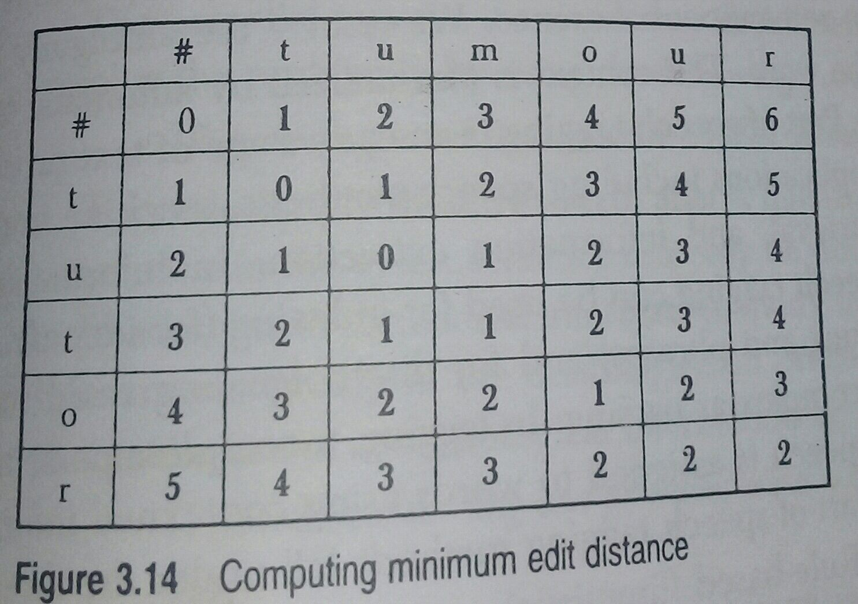
Computation

Slide 41
#
t
u
m
o
u
r
#
0
1
2
3
4
5
6
t
1
0
1
2
3
4
5
u
2
1
0
1
2
3
4
t
3
2
1
1
2
3
4
o
4
3
2
2
1
2
3
r
5
4
3
3
2
2
2

Slide 42
Homework
Compute the minimum edit distance between paecflu and peaceful. P a e c _ f l u
P e a c e f u l

Slide 43
Parts of Speech Tagging
It is the process of assigning in a sentence.
a part-of -speech to each word
The input to a tagging algorithm is sequence of words of natural language sentence and specified tag sets(a finite list of part of speech tags).The output is a single best part of speech tag for each word. Many words belong to more than one lexical category.
For example, the english word 'book' can be a noun as in 'I am reading a good book’ or a verb as in 'The police booked the snatcher’. For example, the hindi word 'sona' may mean 'gold'(noun)or 'sleep'(verb).
In tagging, to determine the correct lexical category depends on its context. The collection of tags used by a particular tagger is called a tag set. Most parts of speech tag sets make use of some basic categories ,i.e noun, verb, adjective, preposition.
Tag sets differ in how they define categories and how finely they divide words into categories.

Slide 44
WORD AND WORD CLASSES
Minimum edit distance algorithms are useful for determining in speech recognition systems. Kemal Oflazer (1996)proposed an efficient algorithm based on spelling correction with finite state automata.
WORD AND WORD CLASSES:
Words are classified into categories called parts of speech. These are also called as word classes or lexical categories. These lexical categories are defined by their syntactic and morphological behaviour. Most common lexical categories are nouns, verbs. Other lexical categories include adjectives, adverbs, prepositions, conjunctions.
Word classes are categorized as open and closed word classes. Open word classes constantly acquire new members while closed word classes do not.
Open word classes are nouns, verbs (except auxiliary verbs), adjectives, adverbs and interjections.
Closed word classes are Prepositions , auxiliary verbs, delimiters, conjunction and particles.

Slide 45
Parts of Speech Tagging
Most tag set capture morpho-syntactic information such as singular/plural, number, gender, tense ,etc.
Consider the following sentence:
  Zuhu eats an apple daily
  Aman ate an apple yesterday
  They have eaten all the apples in the basket
  I like to eat guavas.
The word eat has many forms.
eat – base form ate – past tense
eats – third person singular subject eaten – past participle form

Slide 46
Parts of Speech Tagging
The number of tags used by different taggers varies subsequently, some use 20 while others use 400.
Penn Treebank tag set – 47 tags
C7 – 164
TOSCA ICE – 270 tags
TESS – 200 tags
Larger tag set□greater the information captured about linguistic context.
Task of tagging become more complicated and requires manual correction.
A bigger tag set can be used for morphologically rich languages without introducing too many tagging errors.
A tag set that uses just one tag to denote all the verbs will assign identical tags to all the forms of a verb.
Coarse grained distinction:- appropriate for some tasks.
  Fine grained tag set:-captures more information

Slide 47
Parts of Speech Tagging
Tags From Penn Treebank Tag Set
VB – verb, base form
VBD – verb, past tense
VBG – verb, gerund or present participle
VBN - verb, past participle.
VBP - verb, non third person singular present
VBZ – verb, third person singular present
Possible Tags For The Word To Eat
  Eat – VB
Ate - VBD
Eaten – VBN
Eats – VBP

Slide 48
Parts of Speech Tagging
□ Parts of speech tagging is an early stage of text processing in many NLP application like:
Speech synthesis
Machine translation
Information retrieval
Information extraction.
Parts of speech tagging methods has 3 categories.
Rule based(linguistic)
Stochastic (data driven)
Hybrid.

Slide 49
Parts of Speech Tagging
Rule Based Taggers
□ Use
hand coded rules
to assign tags to words. These rules use a lexicon to obtain a list of candidate tags and then use rules to
discard incorrect tags.
Have a 2 stage architecture:
First stage is simply a each word.
dictionary look up
procedure, which returns a set of potential tags and appropriate syntactic features for
□ Second stage uses
a hand coded rules to
discard contextually illegitimate tags to get a single part of speech for each word.Eg:
The noun-verb ambiguity.
The show must go on.
The potential tags for the word
show
in this sentence is {VB,NN}.
If preceding word is determiner THEN eliminate VB tags. This rule simply disallows verb after a determine using this rule the word show is noun only.
  In addition to contextual information, many taggers use morphological information to help in the disambiguation process.
□
If word ends in _ing and preceding word is a verb THEN label it a verb(VB).
□
The dog is running in the…

Slide 50
Parts of Speech Tagging
Rule based tagger require supervised training
Instead rules can be induced automatically
To induce rules, untagged text is run through a tagger
The output is then manually corrected
The corrected text is then submitted to the tagger, which learns correction rules by comparing the 2 sets of data. This process may be repeated several times.
TAGGIT (Greene and Rubin 1971) :- Initial tagging of Brown Corpus(Francis and Kucera 1982). Rule based s/m, it uses 3,300 disambiguation rules and able to tag 77% of the words in the Brown Corpus with their correct part of speech.
Another rule based tagger is ENGTWOL (voutilainen 1995)

Slide 51
Parts of Speech Tagging
Advantages:
Speed, deterministic than stochastic
Arguments against them is the skill and effort required in writing disambiguation rules
Stochastic taggers require manual work if good performance is to be achieved
Rule based, time is spent in writing a rule set
Stochastic, time is spent developing restriction on transitions and emissions to improve tagger performance
Disadvantages:
It’s usable for only one language. Using it for another one requires a rewrite of most of the programs.

Slide 52
Parts of Speech Tagging
Standard stochastic tagger is HMM tagger algorithm
Markov model applies the simplifying assumption that the probability of a chain of symbols can be approximated in terms of its parts of n-grams
Simplest n-gram model is unigram model, which assigns the most likely tag to each token
Unigram model needs to be trained using a tagged training corpus before it can be used to tag data
The most likely statistics are gathered over the corpus and used for tagging
The context used by the unigram tagger is the text of the word itself
  Ex: It will assign the tag JJ for each occurrence of fast, since fast is used as an adjective more frequently than used as noun, verb or adverb.
She had a fast [noun] Muslims fast[verb] during Ramadan
Those who were injured in the accident need to be helped fast[adverb]

Slide 53
Parts of Speech Tagging
Bigram tagger uses the current word and the tag of previous word in tagging process
She had a fast DT JJ (or) DT NN
As the tag sequence “DT NN” is more likely than the tag sequence “DD JJ”
In general, n gram model considers the current word and the tag of the previous n-1 words in assigning a tag to a word
Tokens
Tags
^{W}n-2
^{t}n-2
^{W}n-1
^{t}n-1
W_{n} t_{n}
^{W}n+1
^{t}n+1
HMM uses 2 layers of states:
Visual layer corresponds to the input words
Hidden layer learnt by the s/m corresponding to the tags

Slide 54
Parts of Speech Tagging
Given a sequence of words, the objective is to find the most probable tag sequence for the sentence Let w be the sequence of words.
W=w_{1,}w_{2,}w_{3,},,,,,w_{n}
The task is to find the tag sequence
^{T=t}1,^{t}2,^{t}3,,,,,,^{t}n
Which maximizes P(T/W) i.e,,
Applying Bayes Rule, P(T/W) can be the estimated using the expression:
P(T/W)= P(W/T) *P(T)/P(W)
The probability of applying for the word sequence, P(W) remains the same for each tag sequence, we can drop it. So, the expression:
T’= argmax_{T} P(W/T) * P(T)

Slide 55
Parts of Speech Tagging
Using the Markov assumptions, the probability of a tag sequence can be estimated as the product of the probability of its constituent n-grams, i.e,,
P(T)=P(t₁)*P(t₂/t₁)*P(t₃/t₂t₁)…..*P(t _{n}/t₁,,,,,t_{n-1})
P(W/T) is the probability of seeing a word sequence, given a tag sequence.
Ex: It’s asking the probability of seeing “ The egg is rotten” given ‘DT NNP VB JJ’ we make the following two assumptions: The words are independent of each other
The probability of a word is dependent only on it’s tag.
Using the assumptions, we obtain P(W/T)=P(w₁/t₁)*P(w₂/t₂)…….P(w_{i}/t_{i} ) *……P(w_{n}/t _{n})
i.e,, P(W/T) = π^{n} P(w /t )
i=1 i i
so, P(W/T)*P(T) = π^{n} P(w /t ) * P(t )*P(t /t )*P(t /t t )…..*P(t /t ,,,,,t )
i=1 i i 1 2 1 3 2 1 n 1 n-1

Slide 56
Parts of Speech Tagging
Approximating the tag history using only the two previous tags, the transition probability, P(T) becomes P(T)= P(t1)*P(t2/t1)*P(t3/t2t1)*…..*P(tn /tn-2 tn-1)
Hence, P(t/w) can be estimated as
P(w/t)*P(T) = πi=1 P(wi/ti ) * P(t1)*P(t2/t1)*P(t3/t2t1)*…..* P(tn /tn-2 tn-1)
= πi=1 P(wi/ti ) * P(t1)*P(t2/t1)* πi=3 P(ti /ti-2 ti-1)
We estimate these probabilities from relative frequencies via maximum likelihood estimation.
P(ti /ti-2 ti-1) = C(ti-2 , ti-1 , ti) C(ti-2 , ti-1)
P(wi/t i ) = C(wi , ti )
C(t i)
Where C(ti-2, ti-1 , ti) is the number of occurrences of t i , followed by ti-2 , ti-1.

Slide 57
Parts of Speech Tagging
Advantage:
Accurate and language independent Drawback:
Require manually tagged corpus for training.

Slide 58
Parts of Speech Tagging- Hybrid Tagger
Hybrid approaches to tagging combine the features of both the rule based and stochastic approaches .
They use rules to assign tags to words .
Like the stochastic taggers ,this is a machine learning techniques and rules are automatically induced from the data.
Transformation-based learning (TBL) of tags ,also known as Brill tagging ,is a example of hybrid approach .
The input to Brill's TBL tagging algorithm is a tagged corpus and a lexicon .
The initial state annotator uses the lexicon to assign the most likely tag to each word as the start state.
An ordered set of transformational rules are are applied sequentially. The rule that result in the most improved tagging is selected.

Slide 59
Parts of Speech Tagging
A manually tagged corpus is used as reference for truth.
The process is iterated until some stopping criteria is reached ,such as when no significant information is achieved over the previous iteration.
At each iteration ,the transformation that results in the highest score is selected.
The output of the algorithm is a ranked list of learned transformation that transform the initial tagging close to correct tagging .
New text can then be annotated by first assigning the most frequent tag and then applying the ranked list of learned transformation in order.

Slide 60
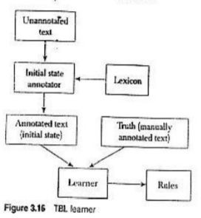
Parts of Speech Tagging

Slide 61
Parts of Speech Tagging
Input:
Tagged corpus and lexicon(with most frequent information)
step1:
Label every word with most likely tag(from dictionary)
step2:
Check every possible transformation and select one which most improves tagging
step3:
Re-tag corpus applying the rules
Repeat 2-3
Until some stopping criterion is reached
RESULT:
Ranked sequence of tranformation rules

Slide 62
Parts of Speech Tagging
Assume that in a corpus,fish is the most likely to be a noun.
P(NN/fish) = 0.91
P(VB/fish) = 0.09
now,consider the following two sentences and their initial tags :
I/PRP like/VB to/TO eat/VB fish/NNP I/PRP like/VB to/TO fish/NNP
The most likely tag for fish in NNP, the tagger assigns this tag to the word in both sentence .In the second case, it is a mistake .
After initial tagging when the transformation rules are applied ,the tagger learns a rule that applies exactly to this mis-tagging of fish. Change NNP to VB of the previous tag in TO.
As the contextual condition is satisfied ,this rule with change fish/NN to fish/VB: like/VB to/TO fish/NN->like/VB to/TO fish/VB

Slide 63
Unknown words
- Unknown words are words that
do not appear in dictionary
or a training corpus.
They create a problem during tagging.
There are several potential solutions to this problem.
i) One is to
assign the most frequent tag
ii) Another solution is to assume that the unknown words can be of any parts of speech and initialize them by
assigning them
open class tags.
- Then proceed
disambiguate
them using the probabilities of these tags.
In this approach, the unknown word is assigned a tag based on the probability of the words belonging to a specific part of speech in the training corpus having the same suffix or prefix

Slide 64
Chapter 2: Syntactic Analysis
Higher level constituents like phrases and sentences.
The word syntax refers to the grammatical arrangement of words in a sentence and their relationship with each other.
The objective is to find the syntactic structure of the sentence.
Nodes in the tree represents the phrases and leaves correspond to the words.
The root of the tree is the whole sentence.
Identifying the syntactic structure is useful in determining the meaning of the sentence.
The identification is done using a process known as parsing.
Syntactic parsing is the process known as parsing.
Two important ideas in natural language
Constituency
Word order
  Constituency- how words are grouped together and how we know that they are really grouped together .
  Word order- how within a constituent , words are ordered with respect to one another.
A widely used mathematical system for modeling constituent structure in natural language is context free grammar (CFG) also known as phrase structure grammar.

Slide 65
Context Free Grammar
CFG was defined for natural language by Chomsky (1957) and used for Algol Programming Language by Backus (1959) and Naur (1960).
CFG also called phrase structure grammar consists of four components:
A set of non-terminal symbols, N A set of terminal symbols, t
A designated start symbol S, one of symbol from N A set of productions, P of the form:
A -> alpha
Where A and alpha is a string consisting of terminal and non-terminal symbols.
The rule A -> a says that constituent A can be rewritten as alpha. This is also called the phrase structure rule. It determines which element can occur in a phrase and in what order.
Eg: The rule S -> NP VP states that S contains of NP followed by VP.
i.e) a sentence consists of noun phrase followed by a verb phrase.

Slide 66
CFG
A language is usually defined through the concept of derivation.
The basic operation is that of appearing on the left hand side of production by its right hand side.
CFG can be used or to assign a structure to a given sentence.
rewriting a symbol
to generate a sentence
Eg: The symbol S can be rewritten as NP VP using Rule 1, then using rules R2 and R4, NP and VP are rewritten as N and V NP respectively. NP is then rewritten as Det N(R3). Finally using rules R6 and R7, we get a sentence : Hena reads a book.
S->NP VP
NP->N VP
VP-> V Np
NP-> det N
The set of all strings containing terminal symbols which can be derived from the start symbol of the grammar, defines the language generated by that grammar.
The parse tree represents a mapping of a string to its parse tree. This mapping is called parsing.

Slide 67
Constituency
Words in a sentence are not tied together as a sequence of parts of speech.
Language puts constraints on word order.
  Eg: Certain words go together with each other more than with others and seem to behave as a unit.
- The fundamental idea of syntax is that words group together to form constituents , each of which acts as a
single unit.
They combine constituents to form larger constituents, The bird, The rain, The Wimbledon court, The beautiful garden are all noun phrases that can occur in the same syntactic context.
For example, they can all function as the subject or the object of a verb.
These constituents combine with others to form a sentence constituent.
Different types of phrases have different internal structure
Phrase level constructions.
Sentence level constructions .

Slide 68
Phrase Level Constructions
Fundamental notion in natural language is that certain group of words behave as constituents.
These constituents are identified by their ability to occur in similar contexts.
Simplest way to decide whether a group of words is a phrase , is to see if it can be substituted with some other group of words without changing the meaning. So, if such a substitution is possible then the set of words form a phrase. This is called substitution test. We can substitute a number of other phrases:
  Hena reads a book.
  Hena reads a story book.
  Those girls reads a book.
  She reads a comic book.
The constituents that can be replaced for each other in these sentences. These are Hena, She, Those girls and a book, a story book and a comic book. These are the words that form a phrase.

Slide 69
Noun Phrase
Phrase types are named after their head which is the lexical category that determines the properties of the phrase
If the head is a noun -the phrase is called noun phrase;
If the head is a verb the phrase is called verb phrase
Noun phrase:
-A noun phrase is a phrase whose head is a noun or a pronoun, accomplished by set of modifiers
-It can function as subject , object or complement determiners or adjective phrase.
-The obligatory constituent of a noun phrase is the noun head all other constituents are optional
-These structure can be represented using the phrase structure rule.
-Phrase structure rules of the form
A->BC, which states that constituent A can be rewritten as two constituents B and C.

Slide 70
Noun phrase
These rules specify which elements can occur in a phrase and in what order NP->Pronoun
NP->Det Noun NP->Noun
NP->Adj Noun
NP->Det Adj Noun
- combine all these rules in a single phrase structure rule as: NP->(Det)(Adj)Noun
-Prepositional phrase(PP) more than one adjective is handled by allowing an adjective phrase(AP) for the adjective in the rule.
After including PP and AP in the phrase structure rule,we get NP->(Det)(AP)Noun(PP)

Slide 71
Noun phrase
They
The foggy morning chilled water
NP->(Det)(AP)Noun(PP)
A beautiful lake in kashmir cold banana shake
The phrase 4.2 a -consists of only a pronoun
4.2 a
4.2 b
4.2 c
4.2 d
4.2 e
4.2 b -consists of a determiner, an adjective(foggy)that stands for an entire adjective phrase and a noun
4.2 c -adjective phrase and a noun
4.2 d -determiner(the),an adjective phrase(beautiful),a noun(lake),and a prepositional phrase(in kashmir)
4.2 e -adjective followed by a sequence of nouns. A noun sequence is termed as nominal
NP->(Det)(AP)Noun(PP)
Nominal->Noun|Noun Nominal

Slide 72
Verb Phrase
-Analogous to the noun phrase, is the verb phrase, which is headed by a verb.
-There are wide ranges of phrases that can modify a verb. This makes verb phrases a bit more complex. ex:
Khushbu slept
The boy kicked the ball Khushbu slept in the garden The boy gave the girl a book
4.4 a
4.4 b
4.4 c
4.4 d
The boy gave the girl a book with blue cover 4.4 e
VP->Verb in 4.4 a
-a verb followed by an noun
-a verb followed by PP
-a verb followed by two NP's
[VP->Verb NP 4.4 b] [VP->Verb PP 4.4 c]
[VP->Verb NP NP 4.4 d]
-a verb followed by two NP's and PP [VP->Verb NP PP 4.4 e]
In general, the number of NP's in VP is limited to two, where as it is possible to add more than two PP's VP->Verb (NP) (NP) (PP) *

Slide 73
Prepositional, Adjective phrases
Prepositional phrases are headed by a preposition. They consist of a preposition, possibly followed by some other constituents, usually a noun phrase.
we played volleyball on the beach. we can have a preposition phrase that consists of just a preposition.
John went outside.
The phrase structure rules that captures the eventualities: PP->Preposition (NP)
Adjective phrase:
The head of an adjective phrase is an adjective.
AP consists of an adjective, which may be preceded by an adverb and followed by a PP. ex:
Ashish is clever AP->Adj
The train is very late AP-> Adv Adj
My sister is fond of animals AP->adj PP
The phrase structure rule for adjective phrase is, AP->(Adv) Adj (PP)

Slide 74
Adverb Phrase
An adverb phrase consists of an adverb, possibly preceded by a degree adverb. Here is an example Time passes very Quickly
Adv P->(Intens) Adv.

Slide 75
Sentence Level construction:
A sentence can have varying structure. The four commonly known structures are
*Declarative structure
*Imperative structure
*yes-no question structure
*Wh-question structure
Declarative:
Sentences with a declarative structure have a subject followed by an predicate The subject of a declarative sentence is a noun phrase and predicate is verb phrase
eg: I like horse riding
The phrase structure rule for declarative sentences is
S->NP VP

Slide 76
Sentence Level construction:
Imperative:
Sentences with an imperative structure usually begin with a verb phrase and lack subject. The subject of these types of sentences is implicit and is understood to be 'you’.
These types of sentences are used for commands and suggestions, and hence are called imperative. The grammar rule
S->VP
ex: Look at the door Give me the book stop talking
Show me the latest design

Slide 77
Sentence Level construction:
Yes-No:
Sentences with the yes-no question structure are questions which can be answered using yes or no. These sentences begin with an auxiliary verb, followed by a subject NP, followed by a VP.
ex: Do you have a red pen? Is there a vacant quarter? Is the game over?
Can you show me your album?
S->Aux NP VP

Slide 78
Sentence Level construction:
Wh-Question
Sentences with wh-question structure are more complex.
These sentence begin with a wh-words ,who , which , where , what , why and how. It have a wh-phrase, as a subject or may include another subject.
Which team won the match?
S->Wh-NP VP
Another type involves more than one NP the auxiliary verb comes before the subject NP
Which cameras can you show me in your shop?
S->WH-NP Aux NP VP

Slide 79
Coordination
Conjoining phrases with conjunctions like ‘and’,’or’ and ‘but’.
Coordinate can consist of two other noun phrases separated by a conjunction ‘and’
noun phrase
I ate[NP[NP an apple] and[NP a banana]] Similarly, verb phrase and prepositional phrases can be conjoined
It is[VP[VP dazzling]and[VP raining]]
Sentence can be conjoined
[S[S I am reading the book] and[ S I am also watching the movie]]

Slide 80
Agreement
Verbs use two different forms in present tense – one for third person singular subjects, and other for all kinds of subjects.
Third person singular form ends with a –s whereas the non-3sg does not.
Does[NP Priya] sing?
Do[NP they] eat?

Slide 81
Feature Structures
Sets of
Can be used to efficiently categories
Features are simply symbols representing properties that we wish to capture
feature value pairs
capture the properties of grammatical
Eg:
The number property
of a noun phrase can be represented by NUMBER feature.
The value that a NUMBER feature can take is SG(singular) and PL(plural)
Values can be extra atomic symbols or feature structures
Feature structures are represented by a matrix-like diagram called attribute value matrix.
Feature1 Feature2 Feature n
Value1 Value2 Valuen

Slide 82
Feature Structures
An AVM consisting of a single NUMBER feature with the value SG is
[ NUMBER SG]
The value of a feature can be left unspecified and represented by an empty pair of square brackets.
[ NUMBER [ ] ]
The feature structure can be used to encode the grammatical category of a constituent and the features associated with it eg:
CAT NP NUMBER SG PERSON 3
Similarly, a third person plural noun phrase can be represented as follows
CAT NP NUMBER PL PERSON 3
The values of CAT and PERSON features remain the same is both structures. Feature values are not limited to atomic symbols. A feature can have another feature structure as its value
Consider the case combining the NUMBER and PERSON features into a single AGREEMENT feature . This makes sense because grammatical subjects must agree their predicates is NUMBER as well as PERSON properties.
Using this new feature, we represent the grammatical category third person plural noun phrase by:
CAT AGREEMENT PERSON 3
NP NUMBER PL

Slide 83
Feature Structures
The two most important operations we need to perform are merging the information content of the two structures that are similar and rejecting structures that are incompatible.
  Unification is implemented as a binary operator[U] that takes two feature structures as arguments and returns a merged feature structure if they are compatible, otherwise reports a failure.
  [ NUMBER PL ] U [NUMBER PL ] = [ NUMBER PL ]
  [ NUMBER PL ] U [NUMBER [ ] ] = [ NUMBER PL ]
  NUMBER feature of the first and second structures have incompatible values.
  [ NUMBER PL ] U [NUMBER SG ] fails.

Slide 84
PARSING
CFG defines the syntax of a language but does not specify how structures are assigned.
The task that uses the rewrite rules of a grammar to either a particular sequence of words or reconstruct its derivation is termed as parsing
The phrase structure tree constructed from a sentence is called a parse
The syntactic parses is thus responsible for recognizing a sentence and assigning a syntactic structure to it
Its possible for many different phrase structure trees to drive the same sequence of words. This means a sentence can have multiple parser. This phenomenon is called syntactic ambiguity
Garden pathing is another phenomenon related to syntactic parsing -> process of constructing a parse by exploring the parse tree along different paths, one after the other till the right one is found
  Eg:- The horse ran past the barn fell

Slide 85
Finding the right parse can be viewed as a search process. The search finds all trees whose root is the start symbols and whose leaves cover exactly the word in the input.
The search space is this conception corresponds to all parse trees defined by the grammar. The following constraints guide the search process:
Input : The first constraint comes from the words on the input sentence. A valid parse is one that covers all the words in a sentence. Hence these words must constitute the leaves of the final parse tree.
Grammar : The second kind of constraint comes from the grammar. The root of the final parse tree must be the start symbol of the grammar

Slide 86
Top down parsing
Starts its search from the root node S and works downward towards the leaves
The input can be derived from the designated start symbol S, of the grammar
The next step is to find all sub trees which can start with S
To generate the sub trees of all second level search expand the root node using all the grammar rules with S on their left hand side
Each non-terminal symbol in the resulting sub trees is expanded next using the grammar rules having a matching non
– terminal symbol on their left hand side
The right hand side of the grammar rules provide the nodes to be generated, which are then expanded recursively
As the expansion continues, the tree grows downward and eventually reaches a state where the bottom of the tree consists of part of speech categories
All trees whose leaves do not match words in the input sentence are rejected, learning only trees that represents successful parses, matches exactly with the words in the input sequence.

Slide 87
S□ NP VP
S□VP
NP□ Det Nominal NP□ noun
NP□ Det noun PP
Nominal□Noun
Nominal□ Noun nominal
VP□ Verb NP
VP□ Verb
PP□ preposition NP
Det□this/that/a/the
Verb□ sleep/sing/saw/open/paint
Preposition□from/with/on/to
Pronoun□she/he/they

Slide 88
“paint the door”
A top down search begins with the start symbol of the grammar. Thus the first level(ply) search tree consists of a single node labeled S.
The grammar in table has two rules with S on their left hand side. These rules are used to expand the tree, which gives us two partial trees at the second level search.
The third level is generated by expanding the non – terminal at the bottom of the search tree is the previous ply. Due to space constraints, only the expansion corresponding to the left most non- terminals has been shown .
The subsequent steps in the parse are left. The correct parse tree is obtained by expanding the fifth parse tree by the third level.
•

Slide 89
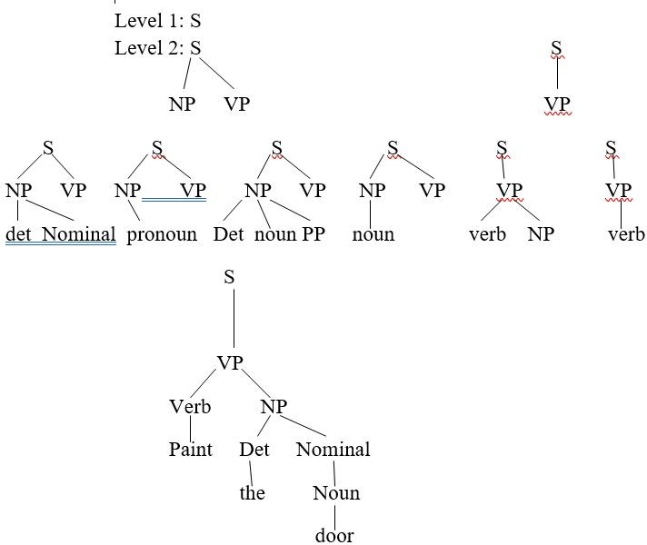

Slide 90
Bottom – up parsing
Starts with the words is the Input sentence and attempts to construct a parse tree is an upward direction towards the root
At each step, the parser looks for rules in grammar where the right hand side matches some of the portions in the parse tree constructed and reduces it using the left hand side of the production
The parse is considered successful of the parser reduces the tree to the start symbol of the grammar.

Slide 91
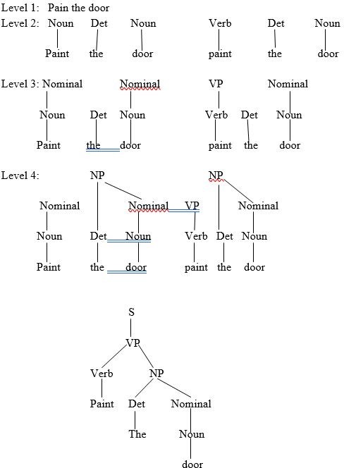

Slide 92
A Basic Top - Down Parser:
The approach presented here is essentially, a depth first, left to right search
The depth first approach expands the search space incrementally by one state at a time. At each step, the left most unexpanded leaf nodes of the tree are expanded first using the relevant rule of the grammar
The left most node is selected for expansion as it determines the order in which input words needs to be considered
When a state arrives that is inconsistent with the input, the search continues by returning to the most recently generated and unexplored tree.

Slide 93
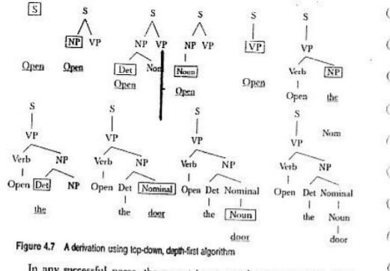
Open the door

Slide 94
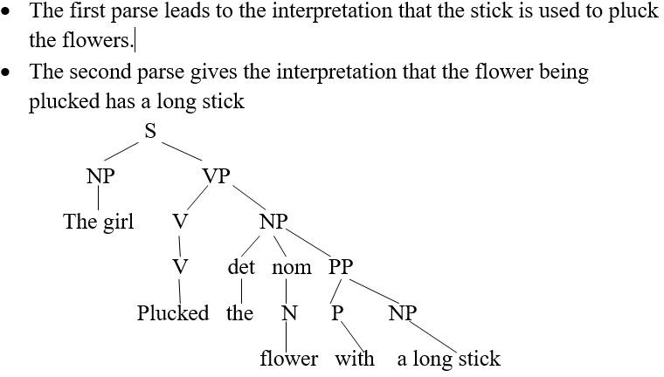
Ambiguity
structural ambiguity which occurs when a grammar assigns more than are parse to a sentence, was the ambiguity that occurs when a word has more than are part of speech associated with it.
A sentence has attachment ambiguity if a constituent fits more than one position in a parse tree. Eg:- The girl plucked the flowers with a long stick.

Slide 95
Ambiguity
Co-ordination ambiguity occurs when it’s not clear which phrases are being combined with a conjunction like and
Eg:- the phrase beautiful hair and eyes have the structure [ beautiful hair] and [ eyes ] or [ beautiful hair ] and [ beautiful eyes ].
A sentence may have local ambiguity resulting in inefficient parsing. Local ambiguity occurs when certain parts of a sentence are ambiguous.
Eg:- paint the door is unambiguous, but during parsing it’s not known whether the first word paint is a verb or a noun. Hence the parser makes a few incorrect expansions before discovering that paint is a verb. Thus it must use backtracking or parallelism to consider both parser.
Repeated parsing
Dynamic programming algorithm can solve the problem.

Slide 96
Earley Parser
Implements a efficient parallel top down search using dynamic programming.
It builds a table of sub-trees for each of the constituents in the input. This way, the algorithm eliminates the repetitive parse of a constituent which arises from backtracking and successfully reduces the
exponential-time problem to polynomial time.
The Earley Parser can handle recursive rules such as A□A C without getting into an infinite loop.
The most important component of this algorithm is the Earley chart that has n+1 entries, where n is the number of words in the input.
The chart contains a set of states for each word position in the sentence. The algorithm makes a left to right scan of input to fill the elements in this chart. It builds a set of states, one for each position in the input string, that describes the condition of the recognition process at that point in the scan. The states in each entry provides the following information:
A subtree corresponding to a grammar rule.
Information about the progress made in completing the subtree Position of the subtree with respect to input.
iii.

Slide 97
Earley Parser
The algorithm uses three operations to process states in the chart:-
Predictor
Scanner S->.NP VP
NP-> Det. N
Det-> .the
5) Completer s->NP VP.
The girl….
3)
4)

Slide 98
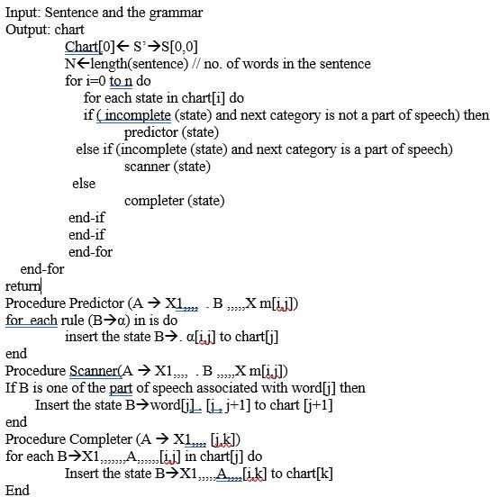
Earley Parser

Slide 99
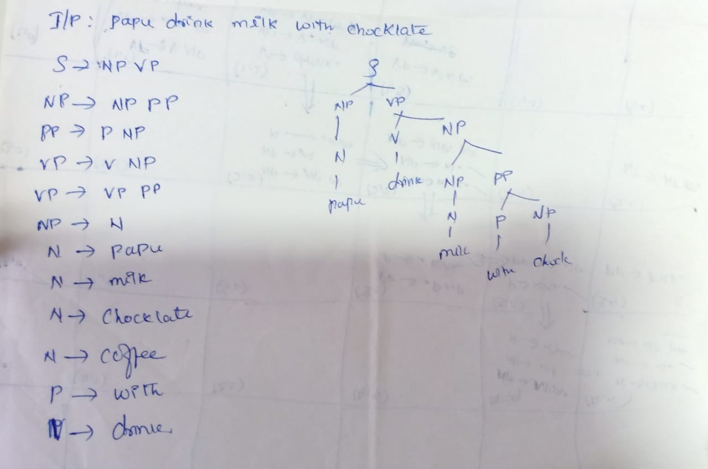

Slide 100
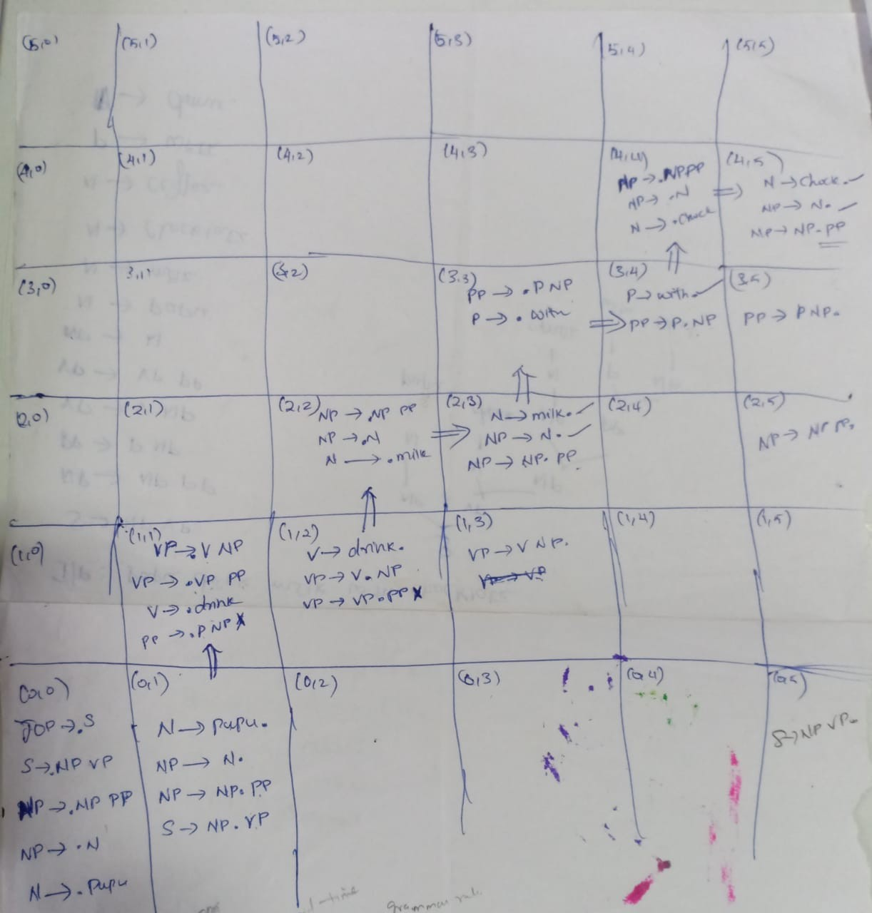

Slide 101
CYK Algorithm
Cocke Younger Kosami
Dynamic programming parsing algorithm
Bottom up approach
Build parse tree incrementally
Each entry based on previous entry.
CNF
A->BC
A->w

Slide 102
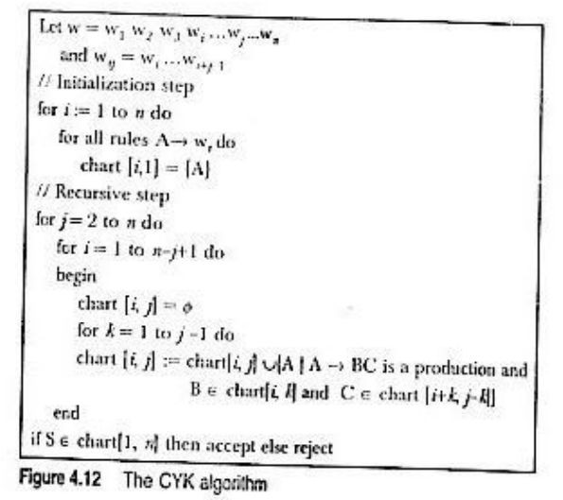
CYK Algorithm

Slide 103
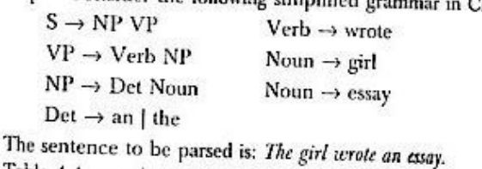
CYK Algorithm

Slide 104
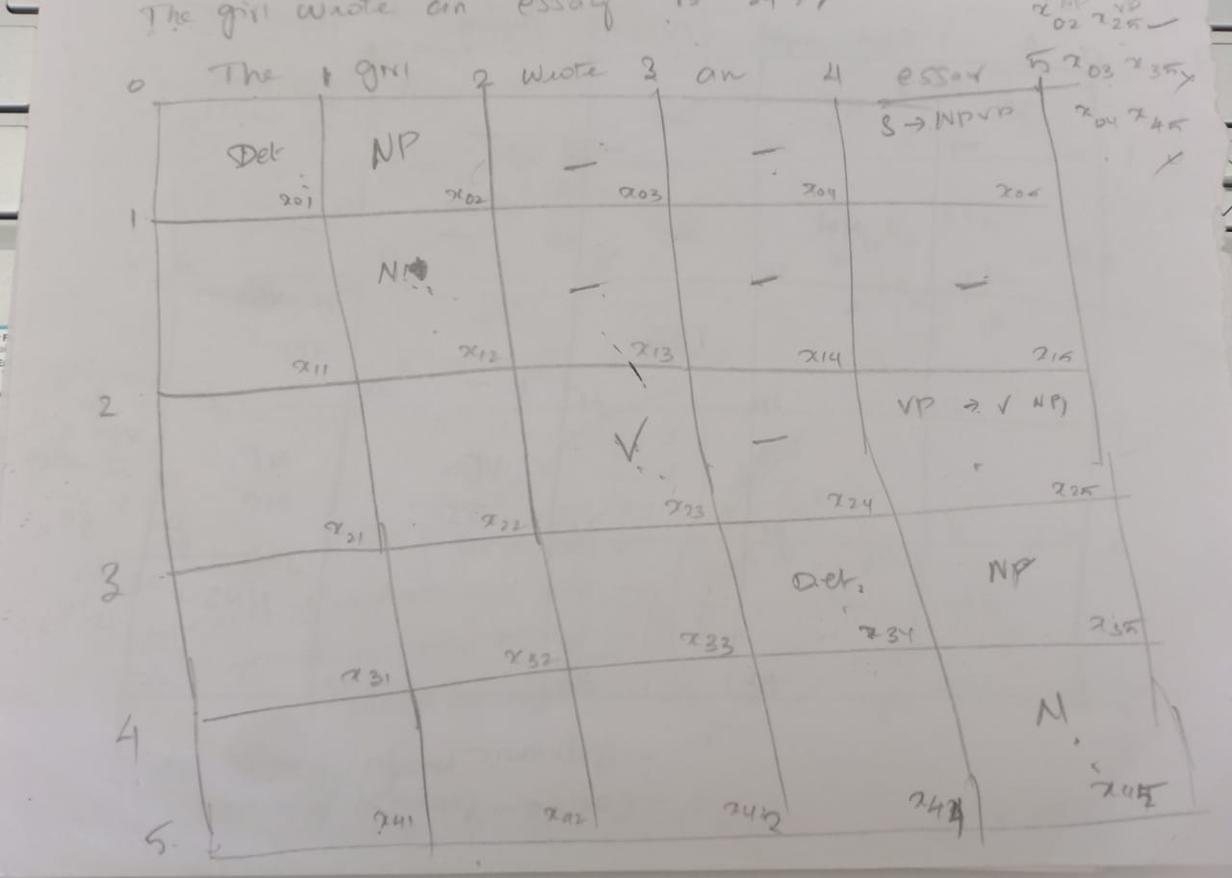

Slide 105
CYK Algorithm
The Girl
Wrote
An
Essay
Det | x01 |  | NP | x02 |  |  | - | x03 |  | -, -, | x04 | S->NP+VP | x05
x11 |  | N |  | x12 |  | - |  | X13 |  | - | x14 | -,X15
X21 |  | x22 |  |  | V |  |  | x23 |  | - | x24 | VP,- | X25
x31 |  | x32 |  |  | x33 |  |  |  | Det |  | x34 | NP | X35
x41 |  | x42 |  |  | x43 |  |  |  | x44 |  |  | N | x45

Slide 106
CYK Algorithm
X02=X01+X12 => Det + N -> NP
X13=x12+x23=> N+V-> nil
X03=x01+x13=Det+-==-
X03=x02+x23=NP+V=-
X14=x12+x24=N+-=-
X14=x13+x34=-

Slide 107
Exercise
1.
2.
3.
4.
5.
6.
7.
8.
9.
10.
11.
12.
13.
14.
15.
The Sun rises in the east
S -> NP VP VP -> V PP PP -> P NP NP -> Det Noun Det -> the Verb -> rises Noun -> sun | east Prep -> in
A pilot likes flying planes S->NP + Vp
vP->VGG+ NNS Vp->vBZ+ NP VP->VBZ+VP NP-> DT + NN NP-> JJ + NNS DT -> a
NN-> pilot VBZ->likes JJ-> flying VBG-> flying
NNS-> planes

Slide 108
Probabilistic Parsing
Statistical parser- stochastic tagger-hand parsed text
Assigning probabilities to possible parses of a sentence? Most likely
Find, Assign, Return
PCFG
Probabilistic parser? assign probabilities to parses.
A->α[p]
PCFG is defined by pair(G,f) where G is a CFG and f is a positive function defined over the set of rules such that, the probabilities associated with rules expanding particular non terminal is 1
∑f(A->α)=1

Slide 109
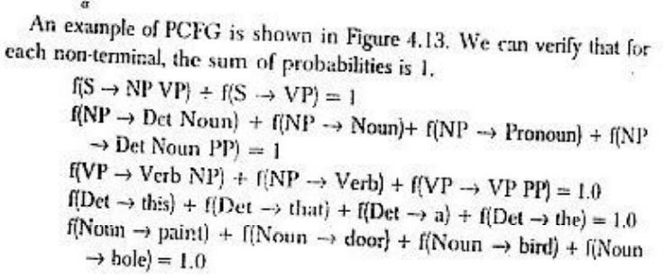

Slide 110
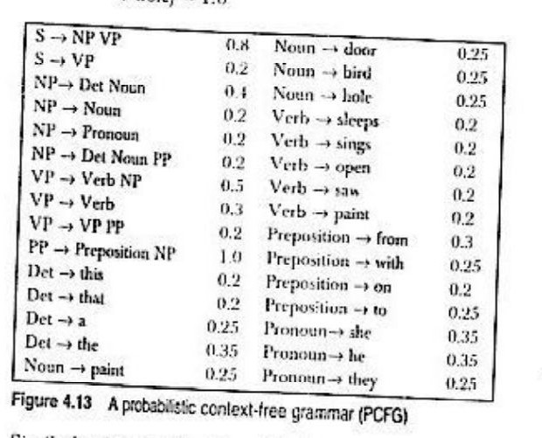

Slide 111
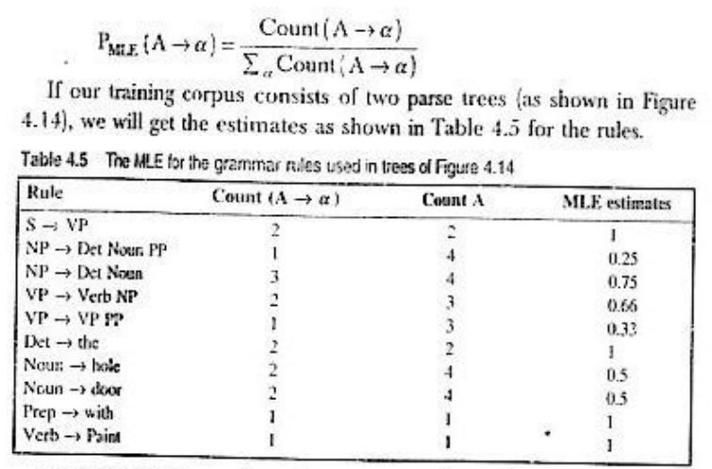

Slide 112
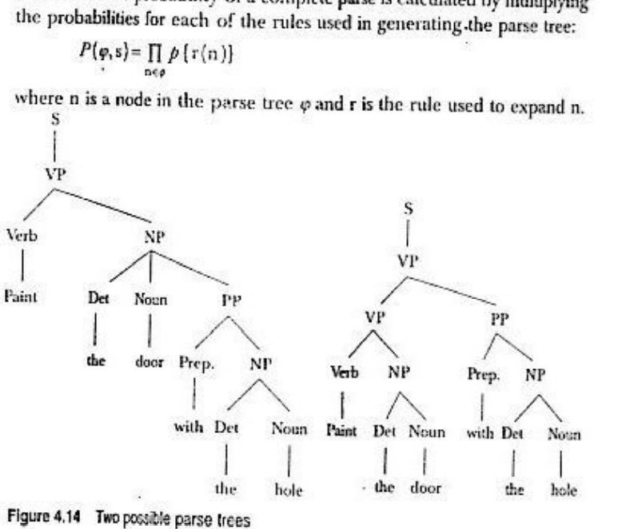

Slide 113
